Slide 1
AZ-220T01 Module 06: Azure IoT Edge Deployment Process

Slide 2
Lesson 01: Learning objectives

Slide 3
Module 6 – Learning objectives
Describe the difference between an IoT device and an IoT Edge device
Configure an IoT Edge device
Implement an IoT Edge deployment using a deployment manifest
Configure an IoT Edge device as a gateway device

Slide 4
Lesson 02: Introduction to Azure IoT Edge

Slide 5
Cloud and Edge Intelligence
There is a natural balance in IoT between the cloud and the edge
Intelligent Cloud
Notes:
This slide and the next few border on pure marketing, but it’s here because it helps set a stage for why we are talking about this at all – it’s the justification for the offering. You can go quickly through them as a result. You’re also welcome to directly call out that they are marketing but that they are here for that reason, if you think the class attendees would react positively to that “spin.”

Slide 6
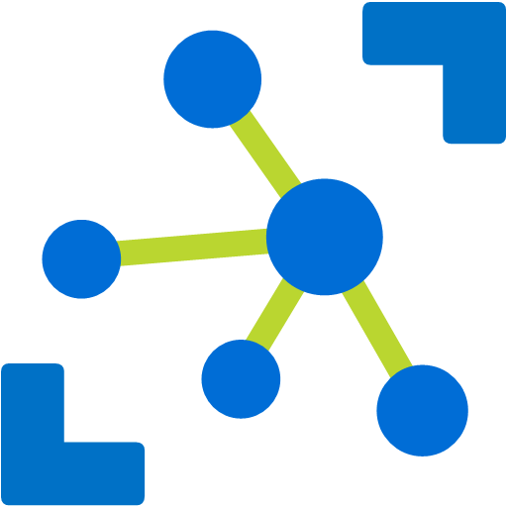

IoT Application Pattern + Edge
Things
Azure IoT Hub
Cloud Gateway
Insights
Actions
Insights
Actions
Notes:
Here, we’re looping back to the original introduction for IoT of “things lead to insights that cause actions” that’s presented early in the course.
“Azure IoT Edge improves IoT solutions by getting local insights and actions…
“The same kinds of insights and actions that were computed in the Cloud can now be brought to the edge, on premises, where the data is being generated, while still getting the benefits of the cloud to manage your things form the Cloud”
This new pattern is really useful to:
Use high value AI on the edge and in the cloud
Reduce solution cost
Respond in real time
Make solutions resilient to Internet connectivity

Slide 7
IoT in the Cloud and on the Edge
IoT in the Cloud
Remote monitoring and management
Merging remote data from multiple IoT devices
Infinite compute and storage to train machine learning and other advanced AI tools
IoT on the Edge
Offline operations (short and long term)
Privacy of data and protection of IP
Pre-process data on prem – E.g. video streams
Low latency tight control loops require near real-time response
Protocol translation & data normalization
Consistency
Notes:
“The Edge capabilities don’t mean the cloud goes away, however… it’s instead enabling the selection of the right tool for the job…”

Slide 8
Bringing Compute To Where The Data Is
Azure Container Registry
IoT Edge Device
Azure
IoT Hub
Data collection
Machine
Learning
Service
Alert
Deployment Manifest
Container
Container
Container
Sensors
Notes:
“Essentially, we’re bringing Azure IoT computing capabilities such as data collection, machine learning, and alerting to the data, with the ability to run code close to the devices and sensors. You’ll notice that the slide mentions containers and Azure Container Registry, because it turns out the Azure IoT Edge implementation is built on top of containers…”

Slide 9
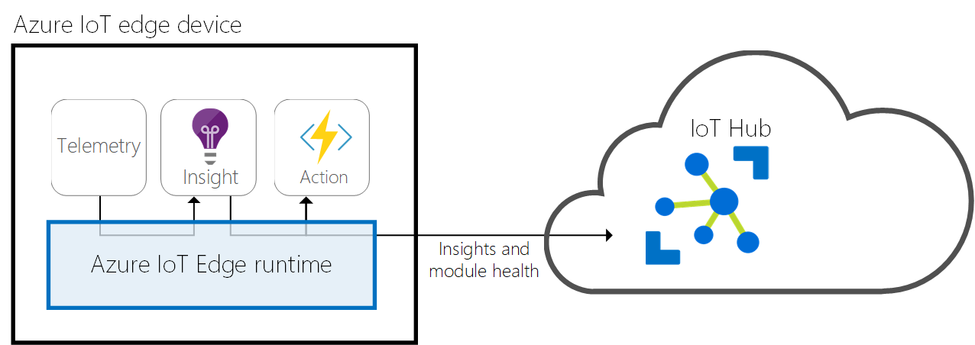
IoT Edge Runtime
Telemetry
Installs and updates workloads on the device.
Maintains Azure IoT Edge security standards on the device.
Ensures that IoT Edge modules are always running.
Reports module health to the cloud for remote monitoring.
Facilitates communication between downstream leaf devices and the IoT Edge device.
Facilitates communication between modules on the IoT Edge device.
Facilitates communication between the IoT Edge device and the cloud
Notes:
Edge runtime – management plane
https://docs.microsoft.com/en-us/azure/iot-edge/iot-edge-runtime
If a student asks about proxy support at any point for the Edge to Azure: https://docs.microsoft.com/en-us/azure/iot-edge/how-to-configure-proxy-support

Slide 10
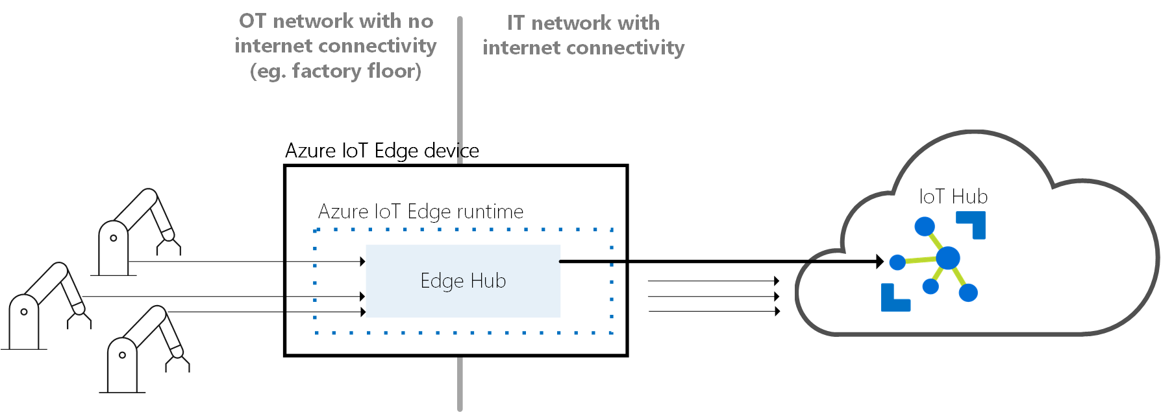
IoT Edge Hub: Offline Support
Notes:
The IoT Edge hub is one of two modules that make up the Azure IoT Edge runtime. It acts as a local proxy for IoT Hub by exposing the same protocol endpoints as IoT Hub. This consistency means that clients (whether devices or modules) can connect to the IoT Edge runtime just as they would to IoT Hub.
Note
IoT Edge hub supports clients that connect using MQTT or AMQP. It does not support clients that use HTTP.
The IoT Edge hub isn't a full version of IoT Hub running locally. IoT Edge hub silently delegates some tasks to IoT Hub. For example, IoT Edge hub forwards authentication requests to IoT Hub when a device first tries to connect. After the first connection is established, security information is cached locally by IoT Edge hub. Future connections from that device are allowed without having to authenticate to the cloud again.
To reduce the bandwidth that your IoT Edge solution uses, the IoT Edge hub optimizes how many actual connections are made to the cloud. IoT Edge hub takes logical connections from modules or downstream devices and combines them for a single physical connection to the cloud. The details of this process are transparent to the rest of the solution. Clients think they have their own connection to the cloud even though they are all being sent over the same connection.
IoT Edge hub can determine whether it's connected to IoT Hub. If the connection is lost, IoT Edge hub saves messages or twin updates locally. Once a connection is reestablished, it syncs all the data. The location used for this temporary cache is determined by a property of the IoT Edge hub’s module twin. The size of the cache is not capped and will grow as long as the device has storage capacity. For more information, see Offline capabilities.

Slide 11
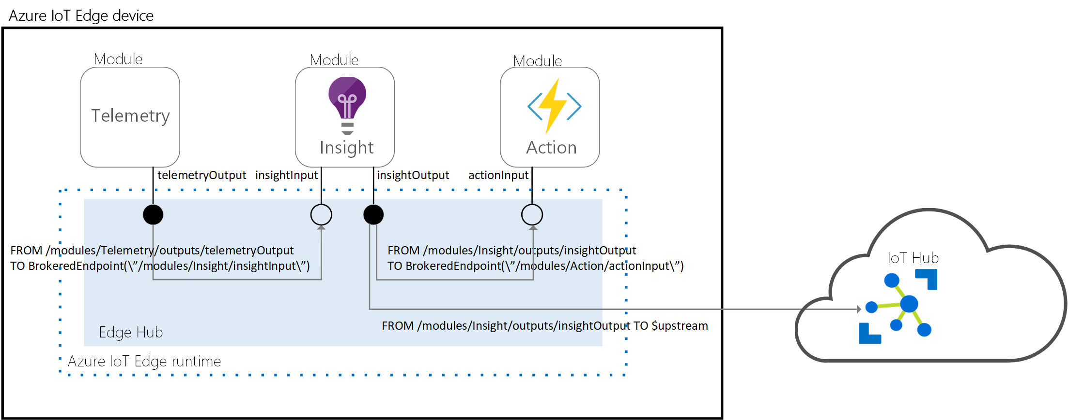
IoT Edge Hub: Module Communications
Notes:
IoT Edge hub facilitates module to module communication. Using IoT Edge hub as a message broker keeps modules independent from each other. Modules only need to specify the inputs on which they accept messages and the outputs to which they write messages. A solution developer can stitch these inputs and outputs together so that the modules process data in the order specific to that solution.
The solution developer is responsible for specifying the rules that determine how IoT Edge hub passes messages between modules. Routing rules are defined in the cloud and pushed down to IoT Edge hub in its module twin. The same syntax for IoT Hub routes is used to define routes between modules in Azure IoT Edge. For more information, see Learn how to deploy modules and establish routes in IoT Edge.

Slide 12
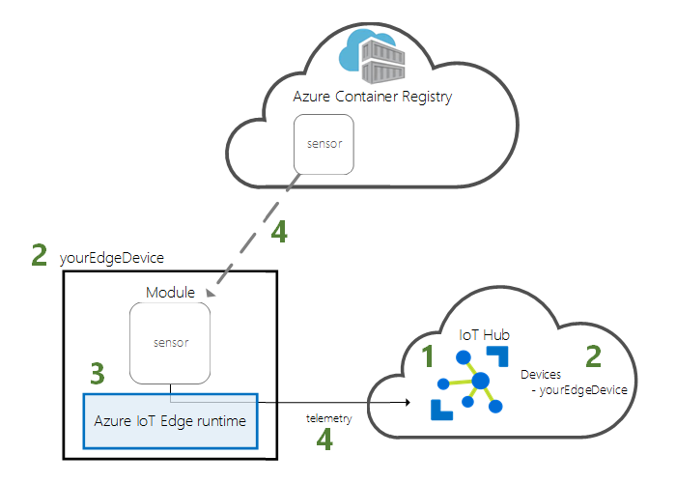
IoT Edge Agent
Notes:
Create hub
Create edge device id
2.5 and configure with connection string
3. Publish module to ACR
4. Put in manifest so it’s read by the runtime
5. Runtime loads the modules from the manifest
Edge Agent: The IoT Edge agent is the other module that makes up the Azure IoT Edge runtime. It is responsible for instantiating modules, ensuring that they continue to run, and reporting the status of the modules back to IoT Hub. Just like any other module, the IoT Edge agent uses its module twin to store this configuration data.
The IoT Edge security daemon starts the IoT Edge agent on device startup. The agent retrieves its module twin from IoT Hub and inspects the deployment manifest. The deployment manifest is a JSON file that declares the modules that need to be started.

Slide 13
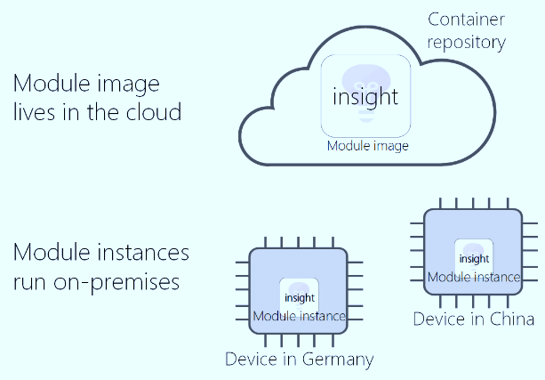
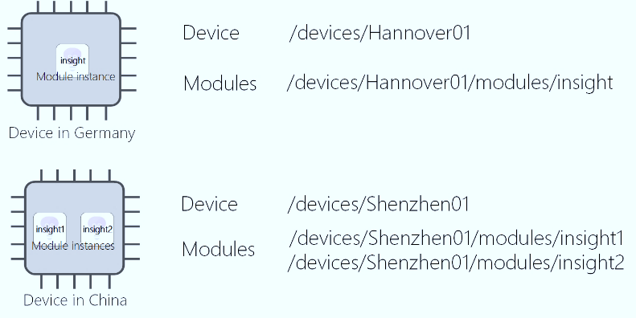
IoT Edge Module
A module image is a package containing the software that defines a module.
A module instance is the specific unit of computation running the module image on an IoT Edge device. The module instance is started by the IoT Edge runtime.
A module identity is a piece of information (including security credentials) stored in IoT Hub, that is associated to each module instance.
A module twin is a JSON document stored in IoT Hub, that contains state information for a module instance, including metadata, configurations, and conditions.
SDKs to develop custom modules in multiple languages (C#, C, Python, Java, Node.JS)
Notes:
Image hosted anywhere – docker hub, ACR etc
Each time a module image is deployed to a device and started by the IoT Edge runtime, a new instance of that module is created. Two devices in different parts of the world could use the same module image. However, each device would have its own module instance when the module is started on the device.
Authentication etc in the SDK

Slide 14
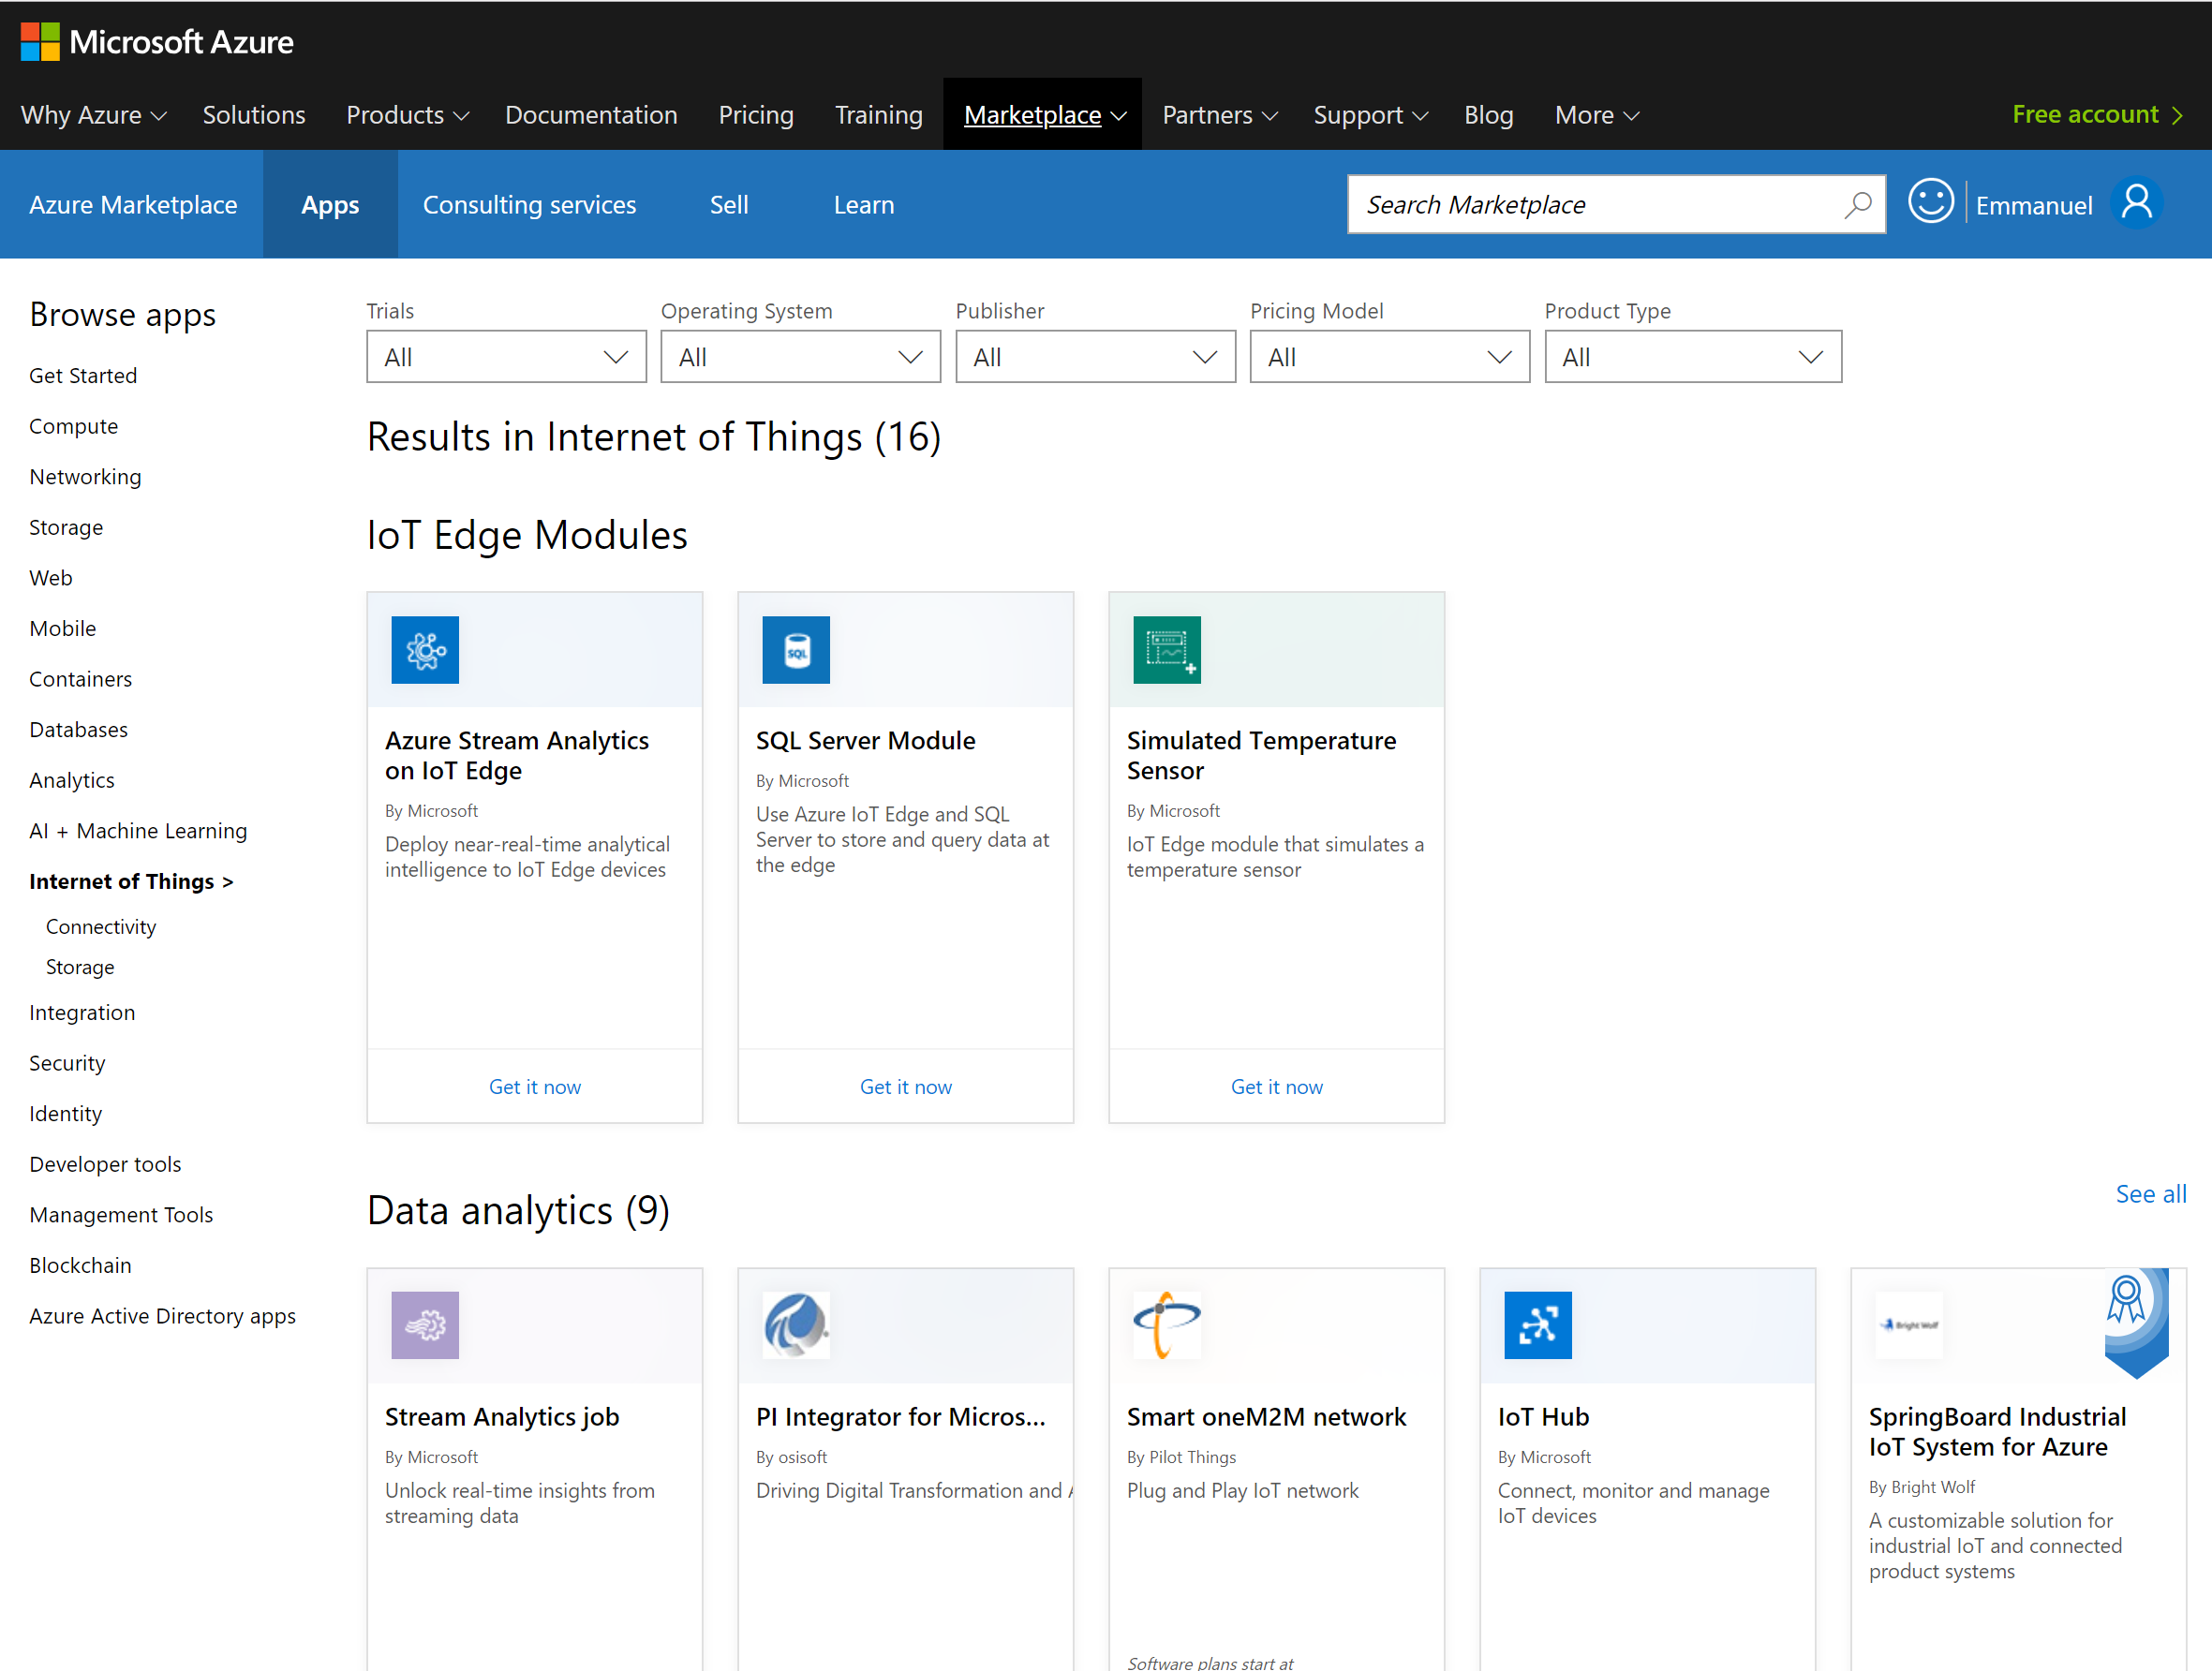
Azure IoT Edge Module on Azure Marketplace
Customers:
Save development effort
Discover and integrate certified pre-built modules
Partners:
Showcase with wide reach
Certified modules gives IoT customers peace of mind for their project
Work with a leader in IoT
Market with Microsoft, and collaborate with other Microsoft IoT partners
Notes:
The Azure IoT Edge module marketplace helps our customers to save development time and cost. Customers can discover pre-built, certified Azure IoT Edge modules that are ready to go through this catalog.
For partners who have an IoT Edge module to share, it helps you by:
Extending your reach by showcasing your solution in an highly visible catalog, deeply integrated with our Azure IoT services
Working with Microsoft, a leader in IoT, to market your solution, gets some leads and insights from the marketplace and collaborate with other MS partners

Slide 15
Module Twin Properties of Edge Runtime Modules
Desired and Reported properties
EdgeAgent properties
Container runtime information
Container registry information, including credentials
List of runtime modules
EdgeHub properties
Routing
Notes:
“Once you’ve decided on using the Azure IoT Edge functionality and selected modules, you need to perform configuration. Earlier in the class, we talked about Azure IoT Device Twins, that have desired properties, indicating the desired configuration, and reported properties, indicating the current configuration. Edge Modules use the same concept for configuration…”

Slide 16
Azure IoT Edge Security
Principles and Goals
Standardized Protocols
Secure technology isolation from app developer
Availability of technology
Protected General Computing
Application execution with runtime integrity checking
Secure Execution Environment
Privileged executions and systems resource access control
Secure Boot/Updates
Bootstrapping and recovery
Hardware Root of Trust
Trust anchor
Notes:
This is an intro to the concepts around IoT Edge Security but there’s more detail coming.

Slide 17
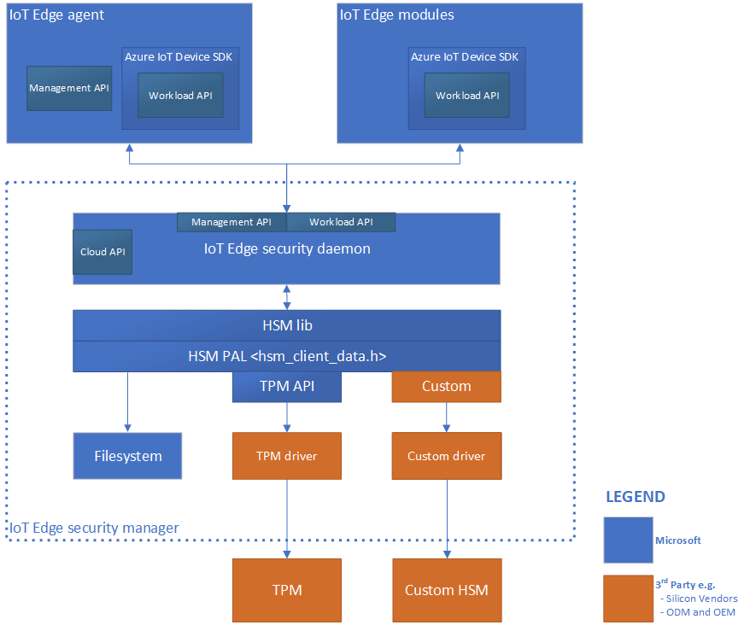
Azure IoT Edge Security Manager
Notes:
IoT Edge security manager aims to defend the integrity of the IoT Edge device and all inherent software operations. The security manager transitions trust from underlying hardware root of trust hardware (if available) to bootstrap the IoT Edge runtime and monitor ongoing operations. The IoT Edge security manager is software working along with secure silicon hardware (where available) to help deliver the highest security assurances possible.
The responsibilities of the IoT Edge security manager include, but aren't limited to:
Secured and measured bootstrapping of the Azure IoT Edge device.
Device identity provisioning and transition of trust where applicable.
Host and protect device components of cloud services like Device Provisioning Service.
Securely provision IoT Edge modules with unique identities.
Gatekeeper to device hardware root of trust through notary services.
Monitor the integrity of IoT Edge operations at runtime.
IoT Edge security manager includes three components:
IoT Edge security daemon.
Hardware security module platform abstraction Layer (HSM PAL).
Optional but highly recommended hardware silicon root of trust or HSM.

Slide 18
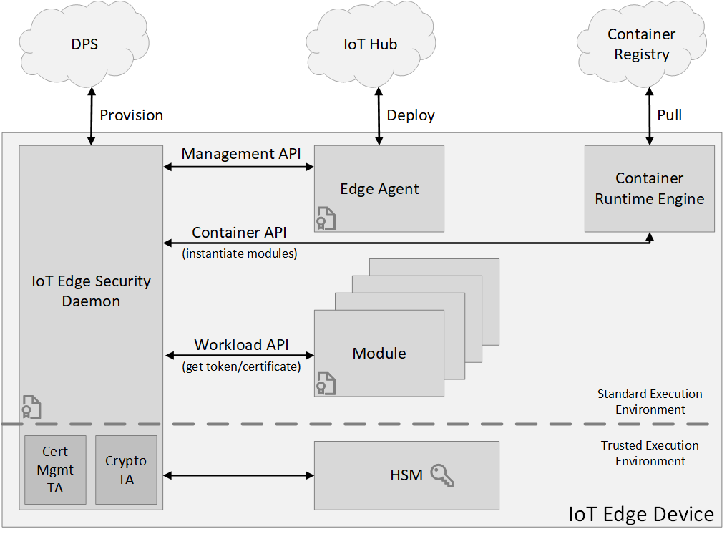
Azure IoT Edge Security Daemon
Notes:
(might be helpful to explain the history/meaning/origin of the term “daemon”)
The IoT Edge security daemon takes advantage of any available hardware root of trust technology for security hardening. It also allows for split-world operation between a standard/rich execution environment (REE) and a trusted execution environment (TEE) when hardware technologies offer trusted execution environments. Role-specific interfaces enable the major components of IoT Edge to assure the integrity of the IoT Edge device and its operations.
Cloud interface
The cloud interface allows the IoT Edge security daemon to access cloud services such as cloud compliments to device security like security renewal. For example, the IoT Edge security daemon currently uses this interface to access the Azure IoT Hub Device Provisioning Service for device identity lifecycle management.
Management API
IoT Edge security daemon offers a management API, which is called by the IoT Edge agent when creating/starting/stopping/removing an IoT Edge module. The security daemon stores “registrations” for all active modules. These registrations map a module’s identity to some properties of the module. For examples, these module properties include the process identifier (pid) of the process running in the container and the hash of the docker container’s contents.
These properties are used by the workload API (described below) to verify that the caller is authorized for an action.
The management API is a privileged API, callable only from the IoT Edge agent. Since the IoT Edge security daemon bootstraps and starts the IoT Edge agent, it verifies that the IoT Edge agent hasn't been tampered with, then it can create an implicit registration for the IoT Edge agent. The same attestation process that the workload API uses also restricts access to the management API to only the IoT Edge agent.
Container API
The container API interacts with the container system in use for module management, like Moby or Docker.
Workload API
The workload API is accessible to all modules. It provides proof of identity, either as an HSM rooted signed token or an X509 certificate, and the corresponding trust bundle to a module. The trust bundle contains CA certificates for all the other servers that the modules should trust.
The IoT Edge security daemon uses an attestation process to guard this API. When a module calls this API, the security daemon attempts to find a registration for the identity. If successful, it uses the properties of the registration to measure the module. If the result of the measurement process matches the registration, a new proof of identity is generated. The corresponding CA certificates (trust bundle) are returned to the module. The module uses this certificate to connect to IoT Hub, other modules, or start a server. When the signed token or certificate nears expiration, it's the responsibility of the module to request a new certificate.

Slide 19
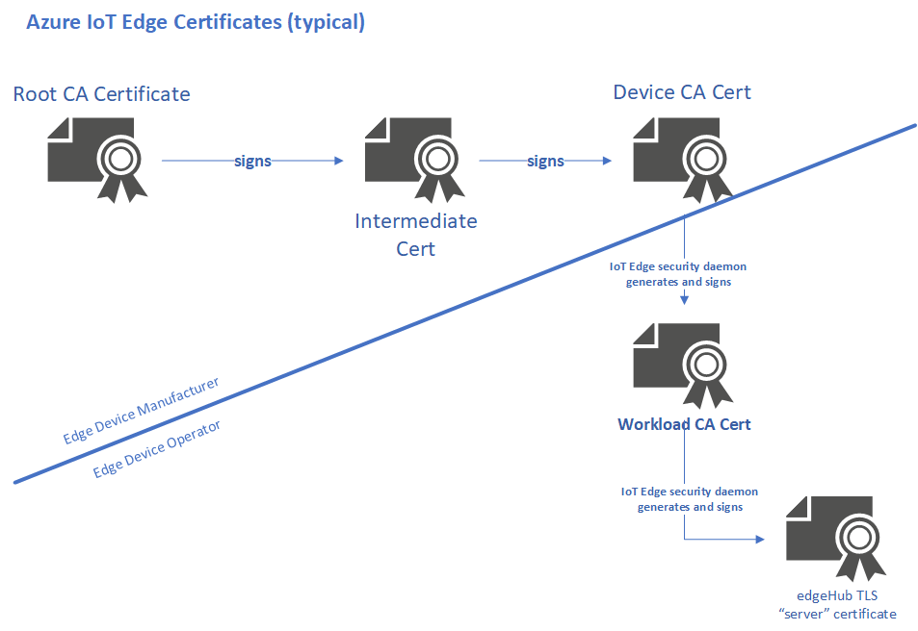
How Azure IoT Edge uses Certificates
Notes:
https://docs.microsoft.com/en-us/azure/iot-edge/iot-edge-certs
Certificate authority
The certificate authority, or 'CA' for short, is an entity that issues digital certificates. A certificate authority acts as a trusted third party between the owner, and the receiver of the certificate. A digital certificate certifies the ownership of a public key by the receiver of the certificate. The certificate chain of trust works by initially issuing a root certificate, which is the basis for trust in all certificates issued by the authority. Afterwards, the owner can use the root certificate to issue additional intermediate certificates ('leaf' certificates).
Root CA certificate
A root CA certificate is the root of trust of the entire process. In production scenarios, this CA certificate is usually purchased from a trusted commercial certificate authority like Baltimore, Verisign, or DigiCert. Should you have complete control over the devices connecting to your IoT Edge devices, it's possible to use a corporate level certificate authority. In either event, the entire certificate chain from the IoT Edge hub up rolls up to it, so the leaf IoT devices must trust the root certificate. You can store the root CA certificate either in the trusted root certificate authority store, or provide the certificate details in your application code.
Intermediate certificates
In a typical manufacturing process for creating secure devices, root CA certificates are rarely used directly, primarily because of the risk of leakage or exposure. The root CA certificate creates and digitally signs one or more intermediate CA certificates. There may only be one, or there may be a chain of these intermediate certificates. Scenarios that would require a chain of intermediate certificates include:
A hierarchy of departments within a manufacturer.
Multiple companies involved serially in the production of a device.
A customer buying a root CA and deriving a signing certificate for the manufacturer to sign the devices they make on that customer's behalf.
In any case, the manufacturer uses an intermediate CA certificate at the end of this chain to sign the device CA certificate placed on the end device. Generally, these intermediate certificates are closely guarded at the manufacturing plant. They undergo strict processes, both physical and electronic for their usage.
Device CA certificate
The device CA certificate is generated from and signed by the final intermediate CA certificate in the process. This certificate is installed on the IoT Edge device itself, preferably in secure storage such as a hardware security module (HSM). In addition, a device CA certificate uniquely identifies an IoT Edge device. The device CA certificate can sign other certificates.
IoT Edge Workload CA
The IoT Edge Security Manager generates the workload CA certificate, the first on the "operator" side of the process, when IoT Edge first starts. This certificate is generated from and signed by the "device CA certificate". This certificate, which is just another intermediate signing certificate, is used to generate and sign any other certificates used by the IoT Edge runtime. Today, that is primarily the IoT Edge hub server certificate discussed in the following section, but in the future may include other certificates for authenticating IoT Edge components.
IoT Edge hub server certificate
The IoT Edge hub server certificate is the actual certificate presented to leaf devices and modules for identity verification during establishment of the TLS connection required by IoT Edge. This certificate presents the full chain of signing certificates used to generate it up to the root CA certificate, which the leaf IoT device must trust. When generated by the IoT Edge Security Manager, the common name (CN), of this IoT Edge hub certificate is set to the 'hostname' property in the config.yaml file after conversion to lower case. This configuration is a common source of confusion with IoT Edge.
A reasonable question might be "why does IoT Edge need the 'workload CA' extra certificate? Couldn't it use the device CA certificate to directly generate the IoT Edge hub server certificate?". Technically, it could. However, the purpose of this "workload" intermediate certificate is to separate concerns between the device manufacturer and the device operator. Imagine a scenario where an IoT Edge device is sold or transferred from one customer to another. You would likely want the device CA certificate provided by the manufacturer to be immutable. However, the "workload" certificates specific to operation of the device should be wiped and recreated for the new deployment.

Slide 20
Azure IoT Edge Device Security Promises
What is the maximum protection you can expect if the device fell into wrong custody?
Edge Agent
Edge
Hub
Edge Modules
Edge Agent
Edge
Hub
Edge Modules
Edge Agent
Edge
Hub
Edge Modules
Azure IoT Edge Security Manager
Azure IoT Edge Security Manager
Azure IoT Edge Security Manager
IoT Edge Security Daemon
IoT Edge Security Daemon
IoT Edge Security Daemon
HSM PAL
[API + Sensitive Logic]
HSM PAL
[API + Sensitive Logic]
HSM PAL
[API]
Secure Enclave
Sensitive Logic
Secure Element
File System
HSM
HSM
Standard Promise
Secure Element Promise
Secure Enclave Promise
HSM PAL = Hardware Secure Module Platform Abstraction Layer
Notes:
In all three cases, the red border indicates the protected area managed by the Security Daemon. As the picture moves from left to right, we’re adding more hardware support for protected areas that gives more physical protection of data.
From the product group:
Standard Promise (No HSM hence $Free) says that even with the best of security engineering in IoT Edge, the device is still susceptible to threats from malicious physical access. The customer can choose this option if they’re confident perimeter security (e.g. devices deployed in a locked IT closet with proper access controls) is sufficient for their needs.
Secure Element Promise (Use of HSM to protect keys, $) offers the option where keys are protected by the HSM. With a good choice of HSM, the device can mitigate certain kinds of threats such as cloning or impersonation even with malicious physical access. Workloads might still be susceptible to dynamic attacks on workloads from malicious physical access. Discrete TPMs are good example of a Secure Element HSMs.
Secure Enclave Promise (Use of HSM to protect keys and workloads, $$$) offer the option where keys and sensitive workloads are protected inside the HSM. With good choice of HSM, the device, in addition to coverage offered by Secure Element promise, can mitigate threats on workloads such as IP theft or data disclosure. HSMs with trusted execution environments (TEE) are good examples of Secure Enclaves.

Slide 21
Lesson 03: Edge Deployment Process

Slide 22
Introduction to IoT Edge Deployment
Deployments can be manual or automatic
Manual deployments are configured per-device
Automatic deployments are configured based on targeting device tags
Notes:
Tags were introduced in Module 2, but it’s reasonable to remind students of what they are about.

Slide 23
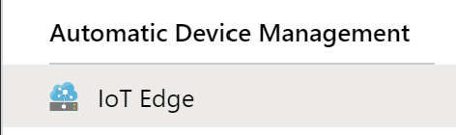

Adding an Edge Device to IoT Hub
CLI: Same as adding a regular device, with an extra setting
Portal: Similar process as adding a device, but in a different area
az iot hub device-identity create --device-id myEdgeDevice --hub-name {hub_name} --edge-enabled true

Slide 24
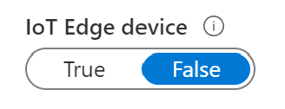
Registering Edge Devices Through DPS
CLI: Same as adding a regular device, with an extra setting
Portal: Same as adding a regular device, with an extra setting
az iot dps enrollment create … --edge-enabled true
Notes:
Important: this requires the replacement IoT module as in https://docs.microsoft.com/en-us/cli/azure/ext/azure-iot/iot/dps/enrollment?view=azure-cli-latest#ext-azure-cli-iot-ext-az-iot-dps-enrollment-create

Slide 25
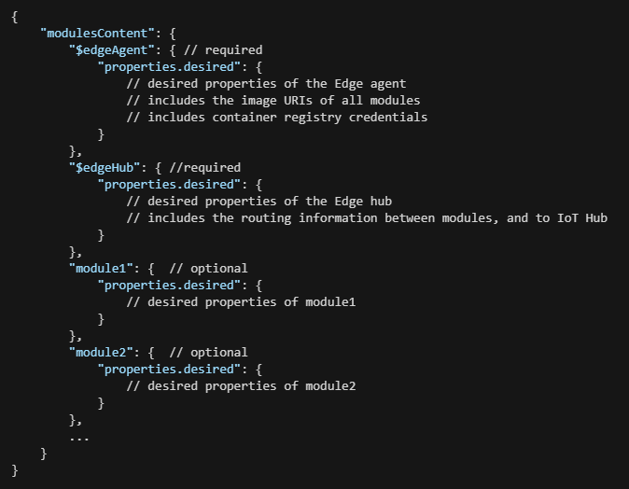
Deployment Manifest (1/3)
Deployment manifests follow this structure
Notes:
Create manifest – basic structure
Configure modules
Declare routes
Define or update desired properties

Slide 26
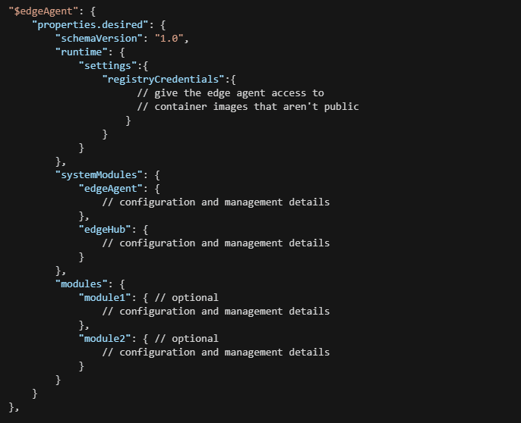
Deployment Manifest (2/3)
The $edgeAgent properties follow this structure
Notes:
Configure modules

Slide 27
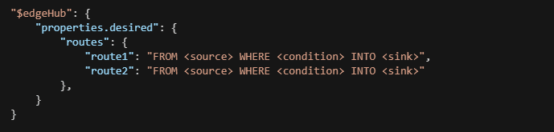
Deployment Manifest (3/3)
Routes are declared in the $edgeHub desired properties with the following syntax
Notes:
Declare routes

Slide 28
Phased Rollout
A phased rollout is an overall process whereby an operator deploys changes to a broadening set of IoT Edge devices.
Deployment is based on targeting… examples:
deviceId = 'linuxprod1'
tags.environment = 'prod'
tags.environment = 'prod' AND tags.location = 'westus'
tags.environment = 'prod' OR tags.location = 'westus'
tags.operator = 'John' AND tags.environment = 'prod' NOT deviceId = 'linuxprod1'
properties.reported.devicemodel = '4000x'
Notes:
Tags were introduced in Module 2, but it’s reasonable to remind students of what they are about.
A phased rollout is an overall process whereby an operator deploys changes to a broadening set of IoT Edge devices. The goal is to make changes gradually to reduce the risk of making wide scale breaking changes. Automatic deployments help manage phased rollouts across a fleet of IoT Edge devices.
A phased rollout is executed in the following phases and steps:
Establish a test environment of IoT Edge devices by provisioning them and setting a device twin tag like tag.environment='test'. The test environment should mirror the production environment that the deployment will eventually target.
Create a deployment including the desired modules and configurations. The targeting condition should target the test IoT Edge device environment.
Validate the new module configuration in the test environment.
Update the deployment to include a subset of production IoT Edge devices by adding a new tag to the targeting condition. Also, ensure that the priority for the deployment is higher than other deployments currently targeted to those devices
Verify that the deployment succeeded on the targeted IoT Devices by viewing the deployment status.
Update the deployment to target all remaining production IoT Edge devices.

Slide 29
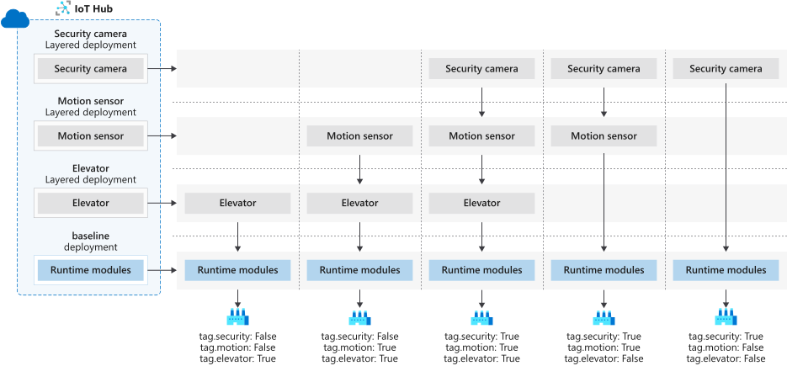
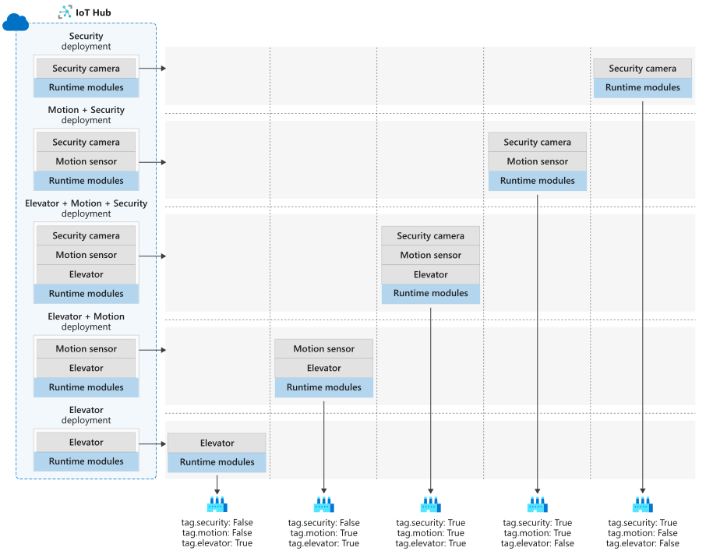
Layered Deployment
A layered deployment allows for minimizing manifest duplication.
Notes:
https://docs.microsoft.com/en-us/azure/iot-edge/module-deployment-monitoring#layered-deployment
This is an animated slide intended to illustrate what an overlapping set of configurations might look like. Refer to the linked-to documentation for more information on the scenario.
We discuss phased rollout first so that targeting is covered, since layered deployment uses targeting (including an optional priority value) to decide which layers apply.

Slide 30
Layered Properties Example
"SimulatedTemperatureSensor": {
"properties.desired": { "SendData": true, "SendInterval": 5 } }
"properties": { "desired": { "SendData": true, "SendInterval": 5, “layeredProperties": { "StopAfterCount": 1000 } } }
“SimulatedTemperatureSensor": {
"properties.desired.layeredProperties": {
"StopAfterCount": 1000
}
}
Notes:
The diagrams on the previous slide and the example on this slide are directly from the documentation. Unfortunately, they are not consistent with each other on the scenario.

Slide 31
Rollback
Deleting a deployment doesn’t remove the configuration from the device… so rollback means doing a new deployment that has the previous configuration
Perform rollbacks in the following sequence:
Confirm that a second deployment is also targeted at the same device set. If the goal of the rollback is to remove all modules, the second deployment should not include any modules.
Modify or remove the target condition expression of the deployment you wish to roll back so that the devices no longer meet the targeting condition.
Verify that the rollback succeeded by viewing the deployment status.

Slide 32
Deployment Checklist
Device configuration
Deployment
Container management
Networking
Solution management
Notes:
https://docs.microsoft.com/en-us/azure/iot-edge/production-checklist
Device configuration
IoT Edge devices can be anything from a Raspberry Pi to a laptop to a virtual machine running on a server. You may have access to the device either physically or through a virtual connection, or it may be isolated for extended periods of time. Either way, you want to make sure that it's configured to work appropriately.
Important
Install production certificates
Have a device management plan
Use Moby as the container engine
Helpful
Choose upstream protocol
Deployment
Helpful
Be consistent with upstream protocol
Set up host storage for system modules
Reduce memory space used by the IoT Edge hub
Do not use debug versions of module images
Container management
Important
Manage access to your container registry
Use tags to manage versions
Networking
Helpful
Review outbound/inbound configuration
Allow connections from IoT Edge devices
Configure communication through a proxy
Solution management
Helpful
Set up logs and diagnostics
Consider tests and CI/CD pipelines

Slide 33
Lesson 04: Edge Gateway Devices

Slide 34
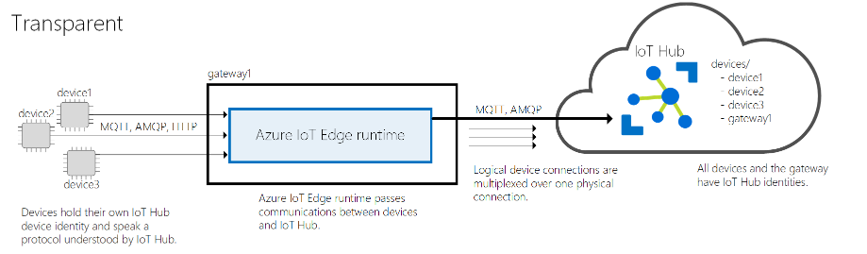
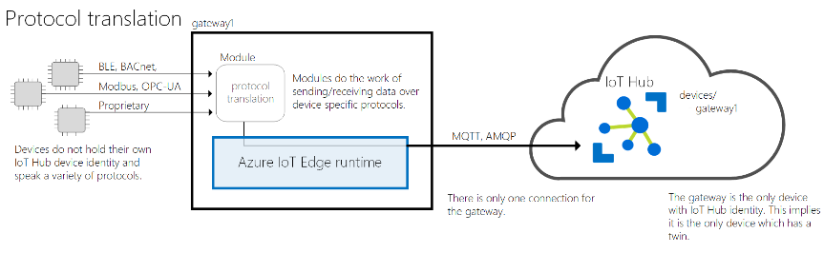
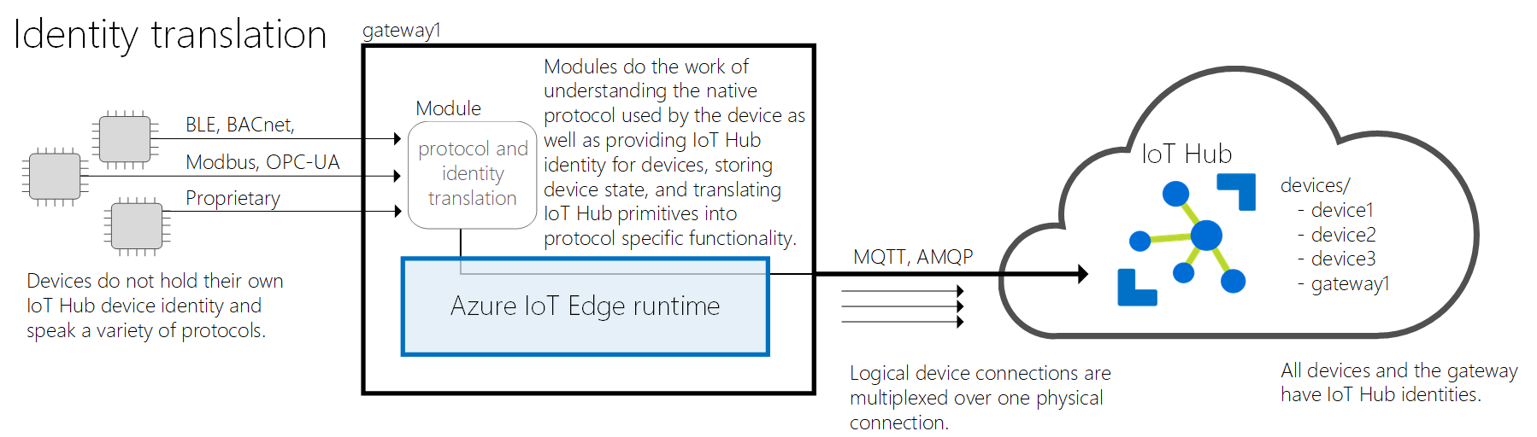
Azure IoT Edge as a Gateway: Patterns
Notes:
The next slide is a summary comparison of the patterns.
All gateway patterns provide the following benefits:
Analytics at the edge – Use AI services locally to process data coming from downstream devices without sending full-fidelity telemetry to the cloud. Find and react to insights locally and only send a subset of data to IoT Hub.
Downstream device isolation – The gateway device can shield all downstream devices from exposure to the internet. It can sit in between an OT network that does not have connectivity and an IT network that provides access to the web.
Connection multiplexing - All devices connecting to IoT Hub through an IoT Edge gateway use the same underlying connection.
Traffic smoothing - The IoT Edge device will automatically implement exponential backoff if IoT Hub throttles traffic, while persisting the messages locally. This benefit makes your solution resilient to spikes in traffic.
Offline support - The gateway device stores messages and twin updates that cannot be delivered to IoT Hub.

Slide 35
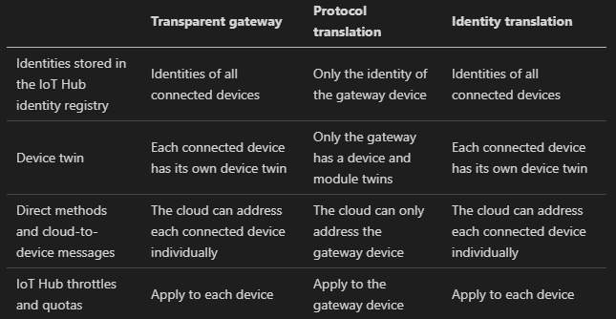
Azure IoT Edge as a Gateway: Pattern Comparison

Slide 36
Authenticate a Downstream Device
Symmetric key authentication
X.509 authentication
Self-signed certificate with a per-device thumbprint
CA-issued by a trusted CA (root or intermediate)
Tied to the device identity in IoT Hub, just like a device without a gateway
Notes:
This is the same basic pattern we’ve seen before, which is part of the point.
https://docs.microsoft.com/en-us/azure/iot-edge/how-to-authenticate-downstream-device
This would be an excellent demo opportunity – show the Portal “Create a device” experience again (you probably showed it earlier), and point out the “Set a parent device” setting.

Slide 37
Lesson 05: Module Labs

Slide 38
Module 6 Labs
Lab 11: Introduction to Azure IoT Edge
Lab 12: Setup an IoT Edge Gateway

Slide 39
Lesson 06: Module 6 review questions

Slide 40
Module Review: Question 6.1
You are developing an IoT solution for your company. You have thousands of IoT devices sending telemetry to your IoT Hub on a regular basis. You are analyzing live-stream and archived data, and you have added business integration to your solution. After initial testing, you realize that certain critical processes require a more immediate response at the device location. You begin investigating the requirements for adding Azure IoT Edge devices to your solution.
Which of the following are required components of an Azure IoT Edge implementation? (choose all correct answers)
IoT Edge modules
IoT Edge runtime
IoT Edge gateway
Linux OS
Notes:
Correct Answer: A, B
Explanation: In the student workbook/skillpipe content, topic What is Azure IoT Edge includes the following:
Azure IoT Edge is made up of three components:
- IoT Edge modules are containers that run Azure services, third-party services, or your own code. Modules are deployed to IoT Edge devices and execute locally on those devices.
- The IoT Edge runtime runs on each IoT Edge device and manages the modules deployed to each device.
- A cloud-based interface enables you to remotely monitor and manage IoT Edge devices.

Slide 41
Module Review: Question 6.2
You are developing an IoT solution for your company. You have thousands of IoT devices sending telemetry to your IoT Hub on a regular basis. You are analyzing live-stream and archived data, and you have added business integration to your solution. After initial testing, you realize that certain critical processes require a more immediate response at the device location. You begin investigating the requirements for adding Azure IoT Edge devices to your solution.
Which of the following functions are performed by the IoT Edge Runtime? (choose all correct answers)
Ensure that IoT Edge modules are always running
Manage communication between modules on the IoT Edge device
Manage communication between the IoT Edge device and the cloud
Manage communication between downstream devices and IoT Edge devices
Notes:
Correct Answer: A, B, C, D
Explanation: In the student workbook/skillpipe content, topic The IoT Edge Runtime includes the following:
The IoT Edge runtime is responsible for the following functions on IoT Edge devices:
- Install and update workloads on the device.
- Maintain Azure IoT Edge security standards on the device.
- Ensure that IoT Edge modules are always running.
- Report module health to the cloud for remote monitoring.
- Manage communication between downstream devices and IoT Edge devices.
- Manage communication between modules on the IoT Edge device.
- Manage communication between the IoT Edge device and the cloud.

Slide 42
Module Review: Question 6.3
You are developing an IoT solution for your company. You have thousands of IoT devices sending telemetry to your IoT Hub on a regular basis. You are analyzing live-stream and archived data, and you have added business integration to your solution. After initial testing, you realize that certain critical processes require a more immediate response at the device location. You begin investigating the requirements for adding Azure IoT Edge devices to your solution.
What is the purpose of the IoT Edge hub? (choose one best answer)
The IoT Edge hub is responsible for deploying and monitoring the edge modules for the IoT Edge device.
The IoT Edge hub is responsible for managing communication between modules and with downstream devices.
The IoT Edge hub is responsible for configuring device settings when the Edge device is configured as an Edge gateway.
The IoT Edge hub is responsible for deploying and monitoring downstream devices when the Edge device is configured as an Edge gateway.
Notes:
Correct Answer: B
Explanation: In the student workbook/skillpipe content, topic The IoT Edge Runtime includes the following:
The IoT Edge hub is responsible for communication, while the IoT Edge agent deploys and monitors the modules.
IoT Edge hub
The IoT Edge hub acts as a local proxy for IoT Hub by exposing the same protocol endpoints as IoT Hub. This consistency means that clients (whether devices or modules) can connect to the IoT Edge runtime just as they would to IoT Hub.
Note: IoT Edge hub supports clients that connect using MQTT or AMQP. It does not support clients that use HTTP.
The IoT Edge hub is not a full version of IoT Hub running locally. There are some things that the IoT Edge hub silently delegates to IoT Hub. For example, IoT Edge hub forwards authentication requests to IoT Hub when a device first tries to connect. After the first connection is established, security information is cached locally by IoT Edge hub. Subsequent connections from that device are allowed without having to authenticate to the cloud.
To reduce the bandwidth your IoT Edge solution uses, the IoT Edge hub optimizes how many actual connections are made to the cloud. IoT Edge hub takes logical connections from clients like modules or downstream devices and combines them for a single physical connection to the cloud. The details of this process are transparent to the rest of the solution. Clients think they have their own connection to the cloud even though they are all being sent over the same connection.

Slide 43
Module Review: Question 6.4
You are developing an IoT solution for your company. You have thousands of IoT devices sending telemetry to your IoT Hub on a regular basis. You are analyzing live-stream and archived data, and you have added business integration to your solution. After initial testing, you realize that certain critical processes require a more immediate response at the device location. You begin investigating the requirements for adding Azure IoT Edge devices to your solution.
What is the purpose of the IoT Edge agent? (choose one best answer)
The IoT Edge agent is responsible for deploying and monitoring the Edge modules for the IoT Edge device.
The IoT Edge agent is responsible for managing communication between modules and with downstream devices.
The IoT Edge agent is responsible for configuring device settings when the Edge device is configured as an Edge gateway.
The IoT Edge agent is responsible for deploying and monitoring downstream devices when the Edge device is configured as an Edge gateway.
Notes:
Correct Answer: A
Explanation: In the student workbook/skillpipe content, topic The IoT Edge Runtime includes the following:
IoT Edge agent
The IoT Edge agent is the other module that makes up the Azure IoT Edge runtime. It is responsible for instantiating modules, ensuring that they continue to run, and reporting the status of the modules back to IoT Hub. This configuration data is written as a property of the IoT Edge agent module twin.
The IoT Edge security daemon starts the IoT Edge agent on device startup. The agent retrieves its module twin from IoT Hub and inspects the deployment manifest. The deployment manifest is a JSON file that declares the modules that need to be started.
Each item in the deployment manifest contains specific information about a module and is used by the IoT Edge agent for controlling the module’s lifecycle.

Slide 44
Module Review: Question 6.5
You are developing an IoT solution for your company. You have thousands of connected IoT devices, you are analyzing live-stream and archived data, and you have added business integration to your solution. You are now adding Azure IoT Edge devices to your solution so that you can implement analytics and machine learning locally on devices rather than in the cloud. You have found some Edge modules in the Marketplace that you want to deploy.
Which of the following are steps in the high-level deployment process for Edge modules? (choose all correct answers)
Remove the device identities from the IoT Hub registry.
Create the deployment manifest.
Configure devices with the desired modules.
Reprovision the devices after configuration.
Retrieve the status of the devices after configuration.
Notes:
Correct Answer: B, C, E
Explanation: In the student workbook/skillpipe content, topic Introduction to IoT Edge Deployment includes the following:
At a high level, IoT Edge automatic deployments include the following:
1. An operator defines a deployment that describes a set of modules as well as the target devices. Each deployment has a deployment manifest that reflects this information.
2. The IoT Hub service communicates with all targeted devices to configure them with the desired modules.
3. The IoT Hub service retrieves status from the IoT Edge devices and makes them available to the operator. For example, an operator can see when an Edge device is not configured successfully or if a module fails during runtime.
4. At any time, new IoT Edge devices that meet the targeting conditions are configured for the deployment. For example, a deployment that targets all IoT Edge devices in Washington State automatically configures a new IoT Edge device once it is provisioned and added to the Washington State device group.

Slide 45
Module Review: Question 6.6
You are developing an IoT solution for your company. You have thousands of connected IoT devices, you are analyzing live-stream and archived data, and you have added business intelligence to your solution both in the cloud and on your Edge devices. You want to add additional capabilities to your solution by connecting devices that are not IP-enabled. You want only the Edge device to have an identity in IoT Hub.
Which Edge Gateway pattern should you use? (choose one best answer)
Transparent.
Protocol translation.
Identity translation.
None of the above.
Notes:
Correct Answer: B
Explanation: In the student workbook/skillpipe content, topic Using an Edge Device as a Gateway includes the following:
There are three patterns for using an IoT Edge device as a gateway: transparent, protocol translation, and identity translation:
Transparent – Devices that theoretically could connect to IoT Hub can connect to a gateway device instead. The downstream devices have their own IoT Hub identities and are using any of the MQTT, AMQP, or HTTP protocols. The gateway simply passes communications between the devices and IoT Hub. The devices are unaware that they are communicating with the cloud via a gateway, and a user interacting with the devices in IoT Hub is unaware of the intermediate gateway device. Thus, the gateway is transparent.
Protocol translation – Also known as an opaque gateway pattern, devices that do not support MQTT, AMQP, or HTTP can use a gateway device to send data to IoT Hub on their behalf. The gateway understands the protocol used by the downstream devices and is the only device that has an identity in IoT Hub. All information looks like it is coming from one device, the gateway. Downstream devices must embed additional identifying information in their messages if cloud applications want to analyze the data on a per-device basis. Additionally, IoT Hub primitives like twins and methods are only available for the gateway device, not downstream devices.
Identity translation - Devices that cannot connect to IoT Hub directly can connect to a gateway device instead. The gateway provides IoT Hub identity and protocol translation on behalf of the downstream devices. The gateway is smart enough to understand the protocol used by the downstream devices, provide them identity, and translate IoT Hub primitives. Downstream devices appear in IoT Hub as first-class devices with twins and methods. A user can interact with the devices in IoT Hub and is unaware of the intermediate gateway device.

Slide 46
Module Review: Question 6.7
are analyzing live-stream and archived data, and you have added business intelligence to your solution both in the cloud and on your Edge devices. You want to add additional capabilities to your solution by connecting devices that are not IP-enabled. You want each device to appear as a separate device in IoT Hub.
Which Edge Gateway pattern should you use? (choose one best answer)
Transparent.
Protocol translation.
Identity translation.
None of the above.
Notes:
Correct Answer: C
Explanation: In the student workbook/skillpipe content, topic Using an Edge Device as a Gateway includes the following:
There are three patterns for using an IoT Edge device as a gateway: transparent, protocol translation, and identity translation:
Transparent – Devices that theoretically could connect to IoT Hub can connect to a gateway device instead. The downstream devices have their own IoT Hub identities and are using any of the MQTT, AMQP, or HTTP protocols. The gateway simply passes communications between the devices and IoT Hub. The devices are unaware that they are communicating with the cloud via a gateway, and a user interacting with the devices in IoT Hub is unaware of the intermediate gateway device. Thus, the gateway is transparent.
Protocol translation – Also known as an opaque gateway pattern, devices that do not support MQTT, AMQP, or HTTP can use a gateway device to send data to IoT Hub on their behalf. The gateway understands the protocol used by the downstream devices and is the only device that has an identity in IoT Hub. All information looks like it is coming from one device, the gateway. Downstream devices must embed additional identifying information in their messages if cloud applications want to analyze the data on a per-device basis. Additionally, IoT Hub primitives like twins and methods are only available for the gateway device, not downstream devices.
Identity translation - Devices that cannot connect to IoT Hub directly can connect to a gateway device instead. The gateway provides IoT Hub identity and protocol translation on behalf of the downstream devices. The gateway is smart enough to understand the protocol used by the downstream devices, provide them identity, and translate IoT Hub primitives. Downstream devices appear in IoT Hub as first-class devices with twins and methods. A user can interact with the devices in IoT Hub and is unaware of the intermediate gateway device.

